Slide 1
PROJECT TITLE
Animated Car Using OpenGL
NAME
Thakor Shubhamkumar
ROLL NUMBER
25051121010006
NAME
Roshan Suthar
ROLL NUMBER
25051121010004
Computer Graphics

Slide 2
COMPUTER GRAPHICS
2D Animation using Translation & Rotation
PROJECT TITLE
Animated Car
Using OpenGL
Animated Car
OpenGL + GLUT
PROJECT NAME
2D Animated Car
C • OpenGL • GLUT

Slide 3
Introduction
02
A simple 2D computer graphics project built with OpenGL and GLUT.
The car is created from basic geometric shapes.
The car moves across a road from left to right.
The wheels rotate while the car is moving.

Slide 4
Project Objectives
03
01
02
03
04
Create
Move
Rotate
Animate
Draw a simple 2D car.
Use translation for car movement.
Rotate both wheels.
Update the scene continuously.

Slide 5
OpenGL Functions Used
04
glBegin() / glEnd() – start and finish drawing shapes.
glColor3f() – set the color of the object.
glVertex2f() – define 2D coordinates.
glTranslatef() – move the car.
glRotatef() – rotate the wheels.
glPushMatrix() / glPopMatrix() – manage transformations.
glutSolidTorus() – create the wheel shape.

Slide 6
How the Program Works
05
1. Open GLUT window
2. Draw road
3. Translate car
4. Draw body + wheels
5. Update position
6. Redisplay

Slide 7
Animation Logic
The timer changes the position and wheel angle repeatedly.
x
Car position
x += 0.01;
angle -= 10;
if (x > 1.3)
x = -1.3;
glutPostRedisplay();
glutTimerFunc(30, update, 0);
angle
Wheel rotation
30 ms
Timer interval

Slide 8
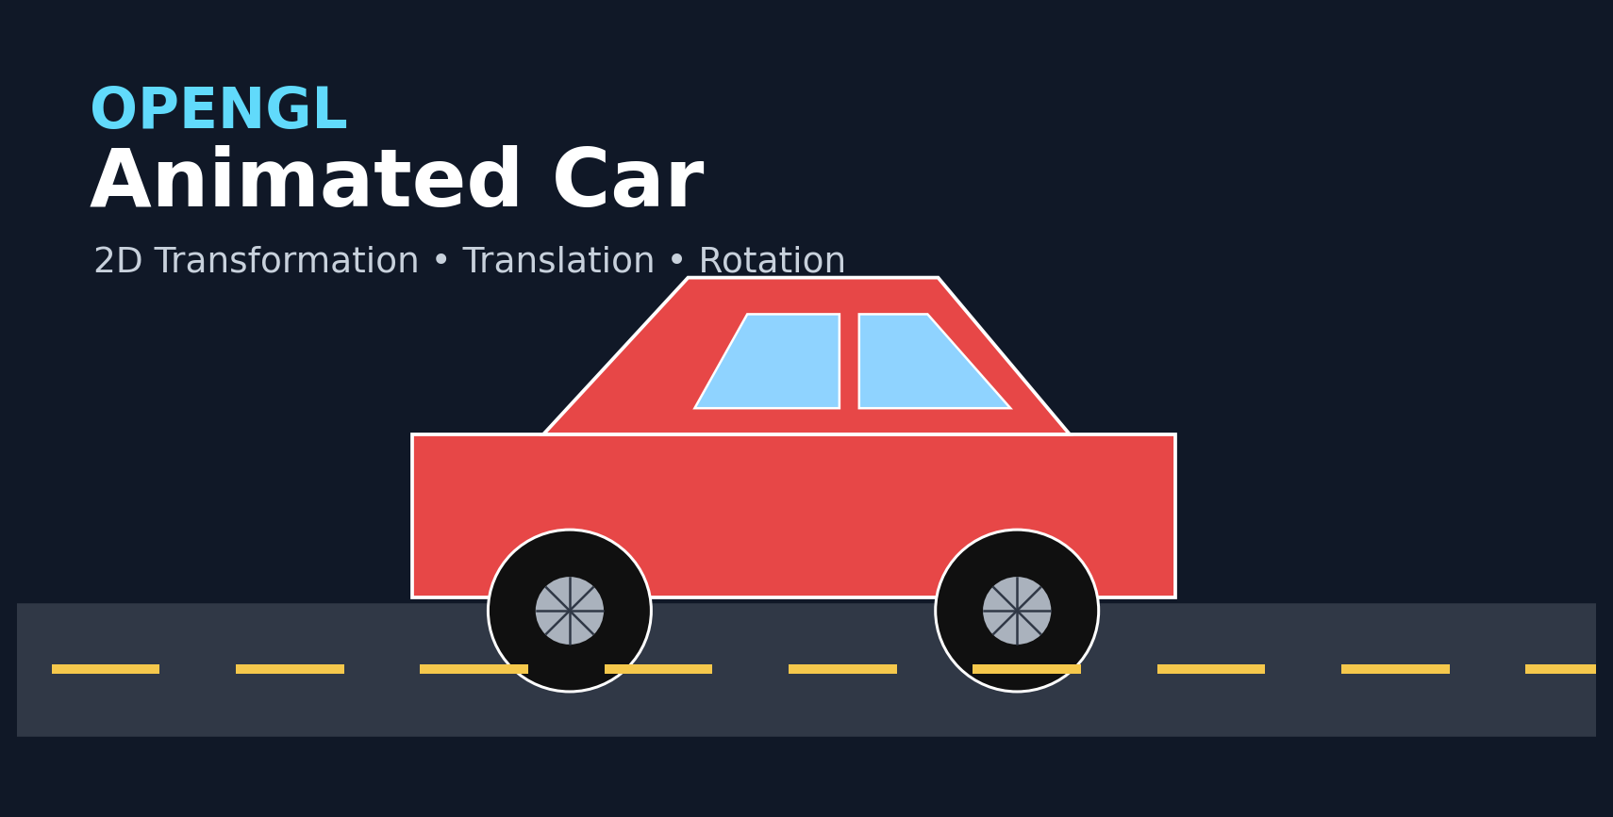
Result / Output
07
The final animation shows:
• Red car on a road
• Continuous left-to-right movement
• Rotating wheels
• Repeating animation

Slide 9
Conclusion
This project demonstrates the basic ideas behind 2D OpenGL animation.
✓ Translation controls the car movement.
✓ Rotation controls the wheel animation.
✓ GLUT provides the window and timer.
✓ Double buffering makes the animation smoother.
Thank You
Questions?

